Slide 1

Hotel booking website
GROUP : TTP
Nguyen Ngoc Hong Phuc 19it5
Nguyen Xuan Thinh 19it5
Huynh Thanh Tuan 19it5

Slide 2
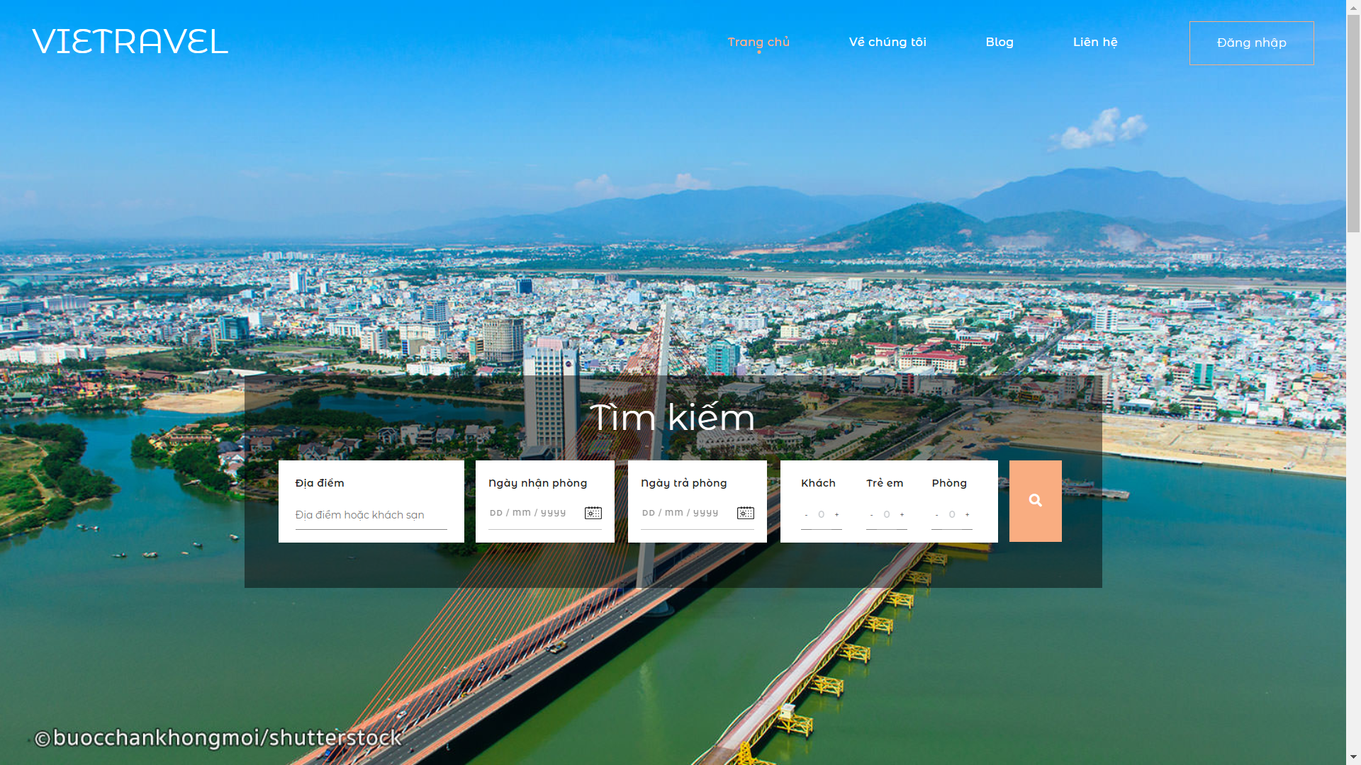
1.Introduction
To meet the needs, an online booking website will be convenient and easily accessible to users.
Based on famous booking websites like traveloka, booking.com to develop.

Slide 3





5 objects:
Booking Hotel
Restaurants and hotels
Ordinary tourists
Foreign tourists
Customers on tour
VIP member

Slide 4





Design technology
HTML
CSS
Bootstrap
JavaScript
Jquery

Slide 5

2. Steps to be taken
2.1.1 Market survey:
Beautiful natural scenery and diverse cultures.
Infrastructure for the tourism industry is focused on investment.
The source of domestic and foreign tourists is plentiful and continuous.
Many hotels are built -> creating great competition between them

Slide 6


2. Steps to be taken
2.2 Create website:
- Technology :
MySql
HTML
CSS
JavaScript
PHP

Slide 7
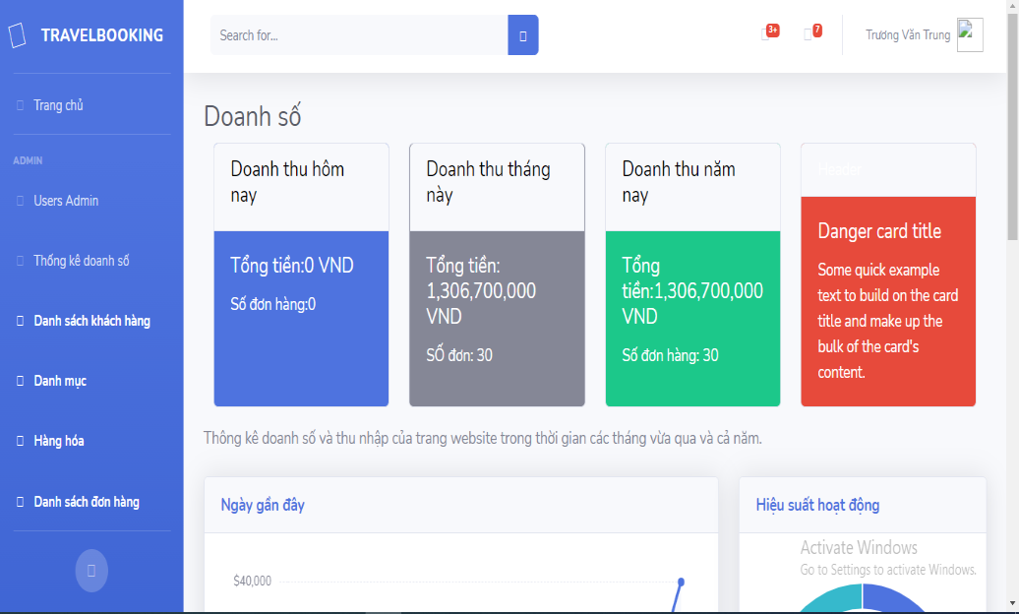
2. Steps to be taken
2.2 Create website:
- For the webmaster:
+ Manage user accounts and hotel
reservations.
+ Control the website's revenue and
activities.
+ Communicate with customers.

Slide 8
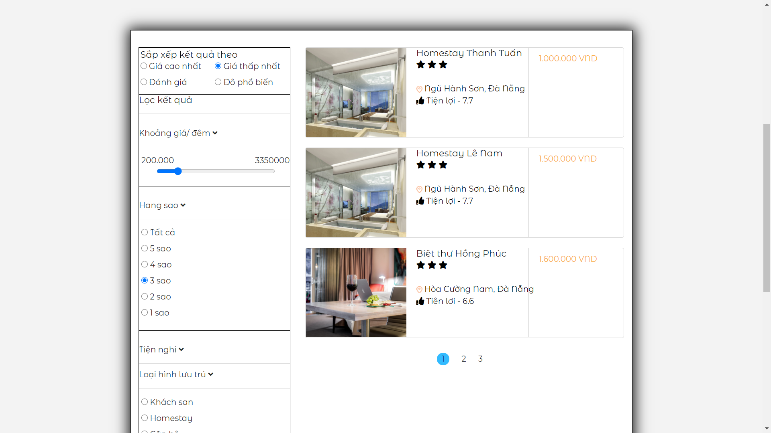
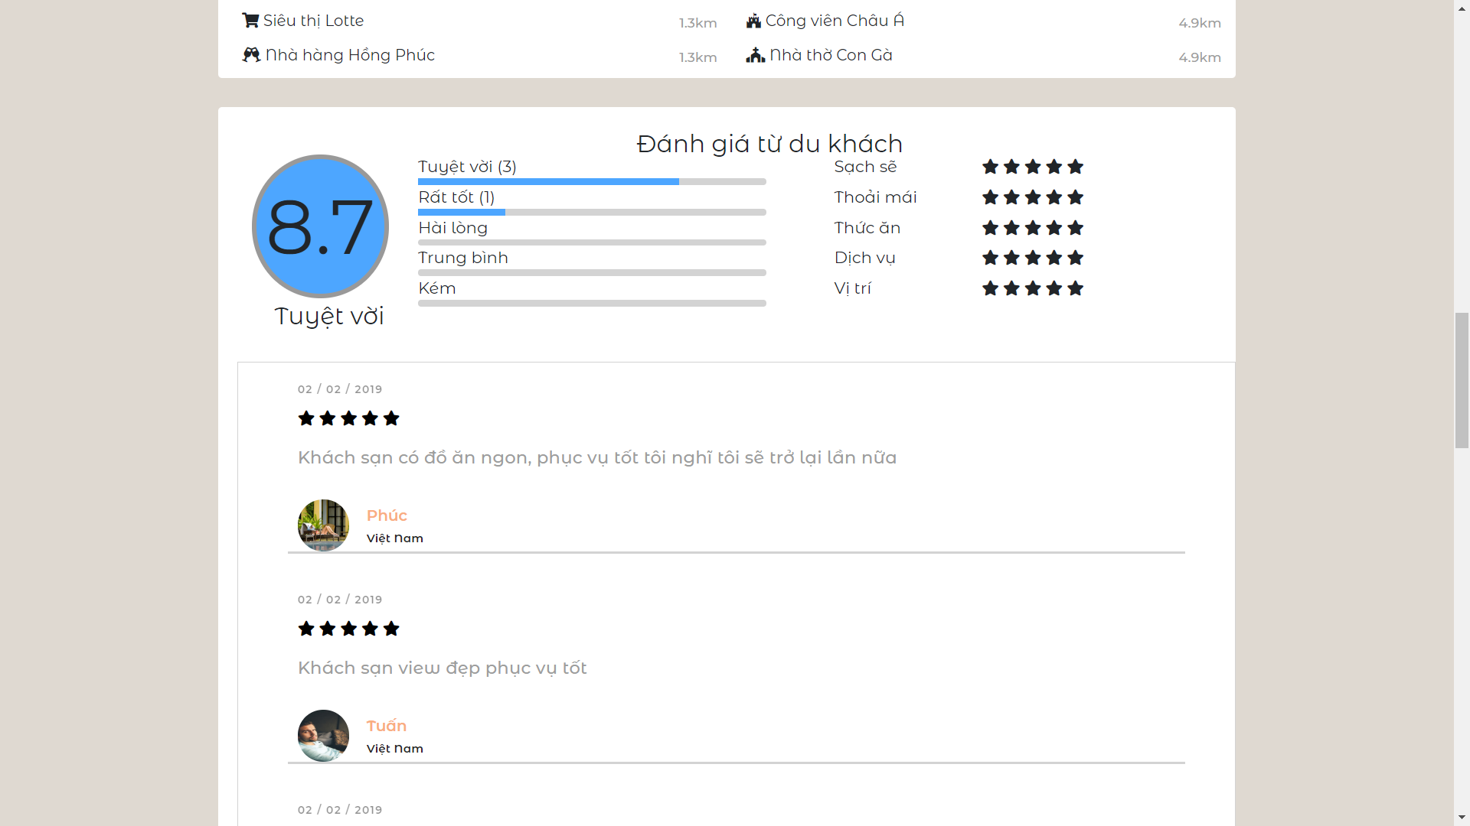
2. Steps to be taken
2.2 Create website:
- For guests who need to find rooms:
+ Help tourists find rooms or guests
hotels according to demand and price.
+ Convenient online payment.
+ Reviews of hotels that have stayed

Slide 9
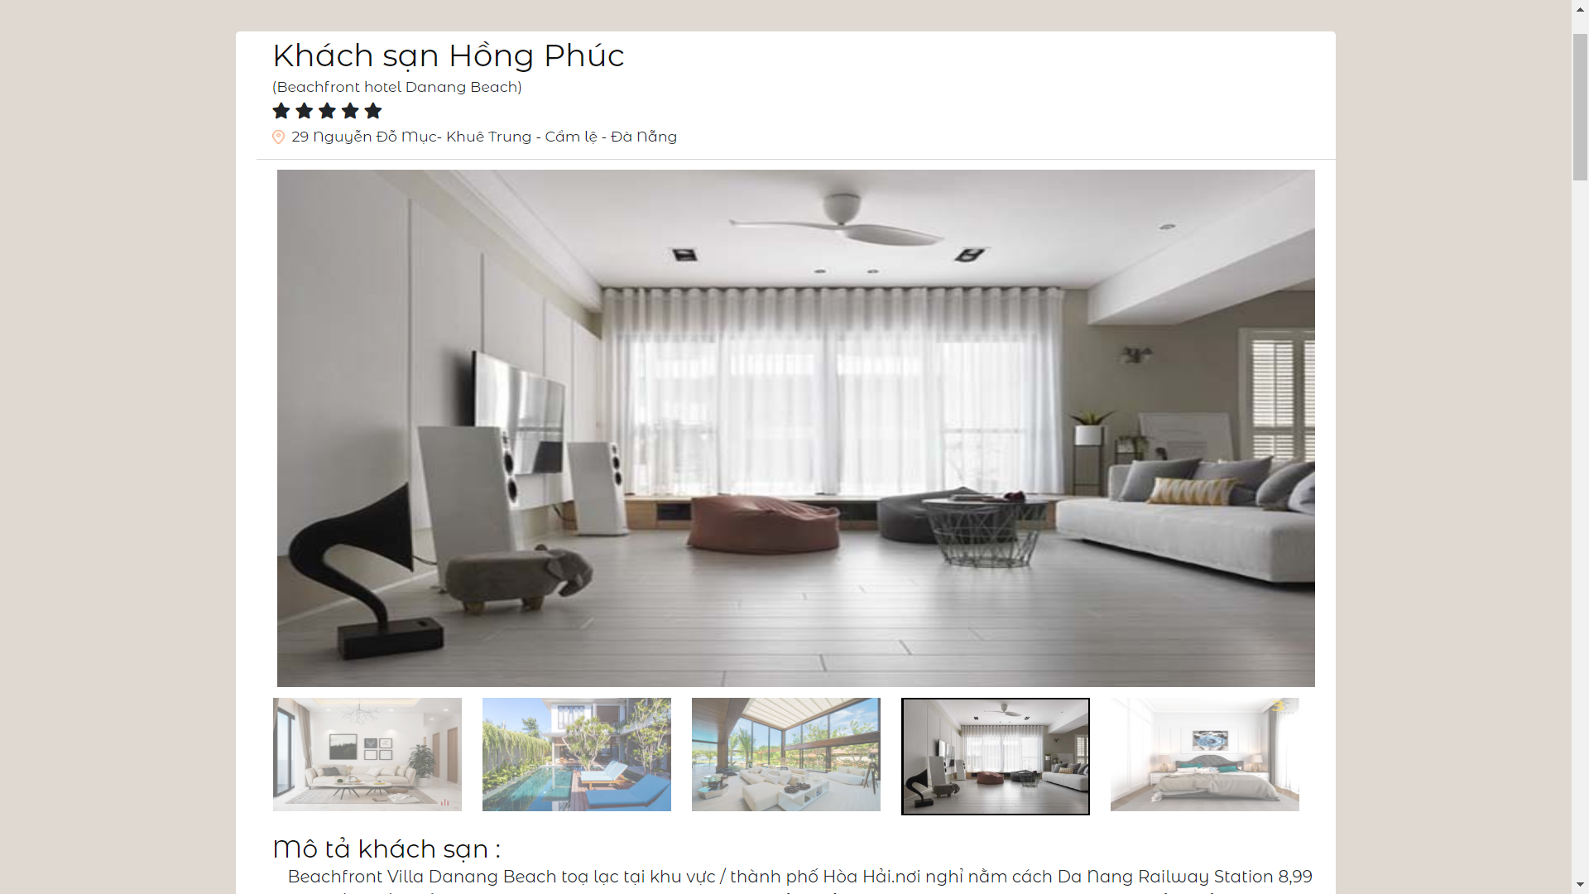
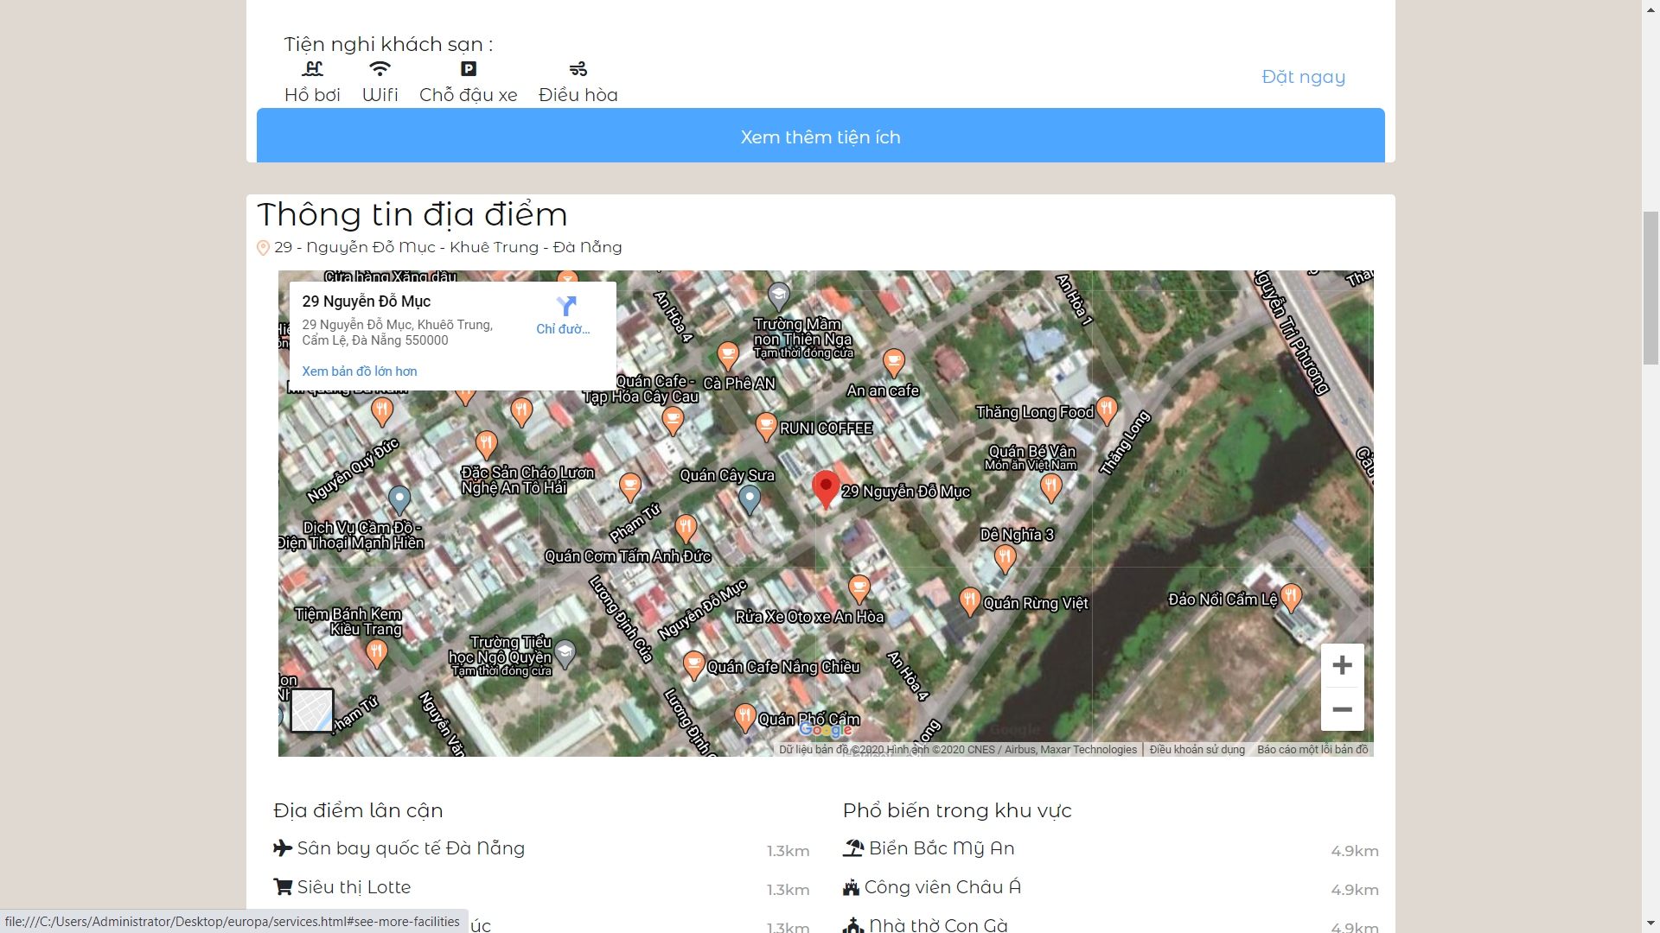
2. Steps to be taken
2.2. Create website:
- For hotels:
+ Show full information about rooms or
the hotel that the hotel wants to convey
to the customer
+ Show user reviews of the hotel

Slide 10
3. The meaning of the topic
Make a place for rent to place banner ads
- Collecting posting fee from hotels on the website (posting hotel information, promotions of that hotel ...)
Pay-per-click advertising with Google AdSense
Build 1 page Review (On this page we write advertising articles, pr for hotels)
Restaurants that pay us will be allowed to write 2 reviews and suggestions under the hotel that the user chooses

